Slide 1



Is a Virtual Spec Building an Option for your Community?
GRASSROOTS ED 201
Kansas Dept. of Commerce
Office of Rural Prosperity
Echelon Arch + Design
Miranda Bruening, NCIDQ
Partner | Project Manager
Independence, KS

Slide 2
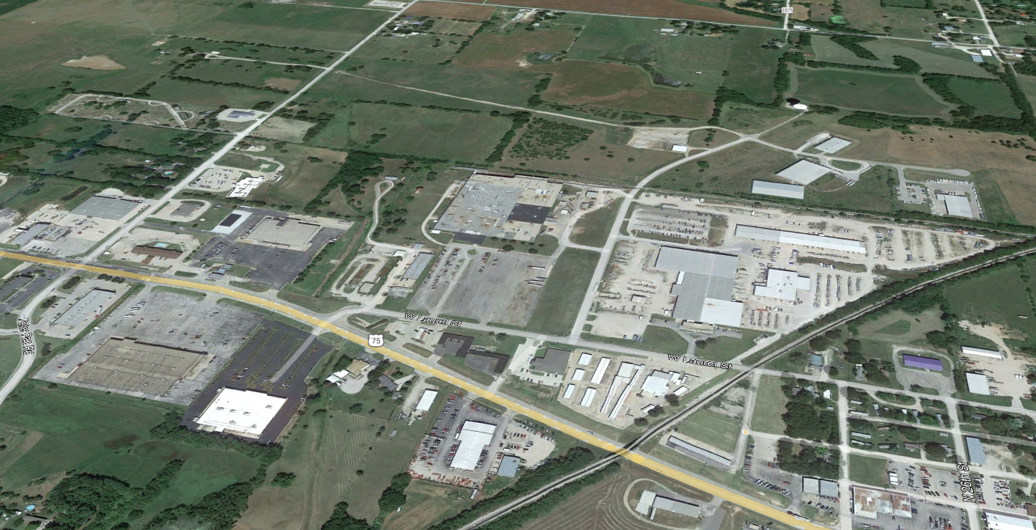
PROPOSAL DEVELOPMENT
DETERMINATIONS
WHAT SITE NEEDS ARE in terms of access and infrastructure
BUILDING TYPE AND FUNCTION
Community amenities
LEVEL OF MARKETING
BUDGET
AND STEPS TAKEN
Notes:
Lets start with our first meeting with the community. We will determine many factors that go into our proposal and the marketability of your site. First we would like to know what are your site needs? Do you need additional roads or infrastructure built to get to the site? Is the site flat or is there a lot of elevation? Detention areas? Next we move on to What type of business does your industrial park want to draw? What is the common function of the businesses in the park or is there common functions? Is there a business type that we want to avoid marketing to? Last, what are the community amenities? What would draw developers to this site? Do you have appropriate housing and daycare for mass employment? Is there essential stores like grocery, healthcare situation, education, etc. Community function is a component that we need to ensure we touch on as developers look into this area as part of their decision process as well. Once we understand the site and the community better, we will discuss what level of marketing materials you are wanting as well as the budget you have for generating these materials. We have standard packages, but each communities' needs are different, so we like to tailor a package to fit what best suits the need.

Slide 3
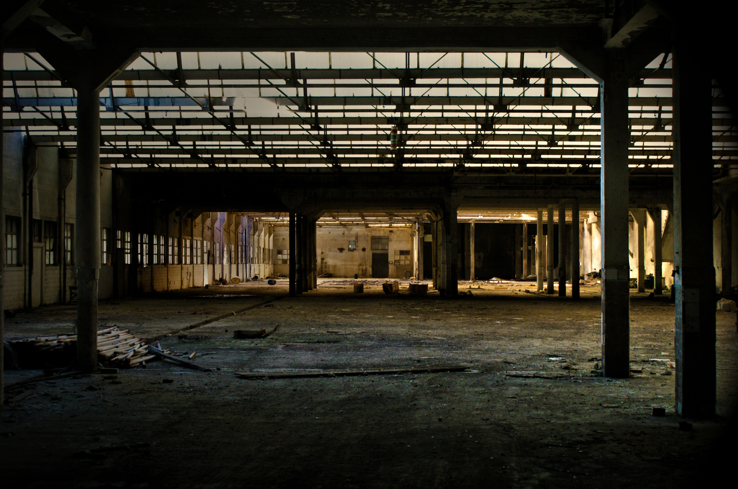
BENEFITS AND USES
MARKETABILITY
VISUAL MATERIALS
AID IN DEMENSTRATING POSSIBLE FUNCTIONS OF SITE
Options for reuse of existing unoccupied building
Easier and wider EXPOSURE
FOR A VIRTUAL SPEC BUILDING
Notes:
Once our proposal is agreed upon, we begin generating the Virtual Spec Building package. There are many benefits to having a spec plan worked out prior to mass marketing your site. The general public is very visual, you would be surprised at the amount of people who have a hard time conceptualizing space. When you provide visual materials that show people options for the site and space you are trying to sell them on, it becomes a much smoother process. These materials can aid in demonstrating possible functions of an empty lot. Try to visualize what an 8 acre lot looks like, then put a 25,000 square foot building on it. Its very hard to do this without having something to scale to look at. Our marketing brochure helps put concepts on paper and in context for more people to easily understand. On the flip side of that, lets say you have an existing building that is completely open on the inside but has been unoccupied for so long its under disrepair and visually is unappealing in pictures. We can take that building footprint and do some interior renderings of the space to take place of the existing imagery to allow for the developer to see what it could be instead of what it currently is. Having these types of materials on hand also allows you to widen your market exposure. You can put this out on social media and catch attention, put it in mailing distribution lists, have handouts made, email marketing blasts. The reach you can get really is endless and only aids in drawing the attention of interested parties when your marketing materials cut out their need for conceptual creativity.

Slide 4

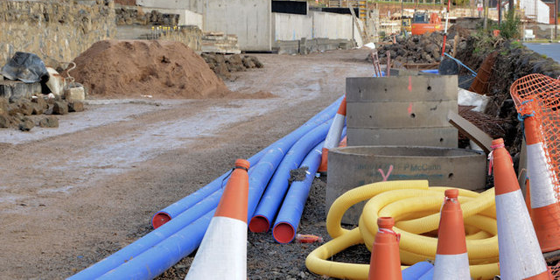

COMMUNITY
Items to establish
Zoning and planning
Landscape ordinances
SITE INFRASTRUCTURE
ROADWAY ACCESS
VISIBILITY / SIGNAGE
Tax Break incentive
WHAT NEEDS TO BE IN PLACE ALREADY?
Notes:
Lets talk about the community contributions. The first thing a community needs to ensure they have in place is the zoning and planning ordinances for the Industrial Park or proposed site / lot. These include details on how and what can be built in those areas was well thoughts on if you will require landscaping and such in the areas. When all of these items are pre-determined then this allows for the lots to become Pre-permitted and approved locations which have many advantages when time of construction is critical. We call these lots “shovel-ready”. This offers a significant time advantage to developers who have a project that aligns with what is already approved. Having things like site utility infrastructure and roadways already in place and built are also big ticket items on the marketability of your lot. Developers are looking for ease of access, does the site have visibility? If not, is there signage in place to easily direct traffic to their lot? Things like this are all key factors in ensuring that the community is ready for a developer to be able to quickly move on a decision. Keep in mind when you are looking at the site infrastructure aspect. Most big manufacturing and industrial buildings need to be sprinklered. You need to ensure your water pressure to the site is adequate to provide enough flow for a sprinkler system. If your park isn’t new, but already established, make sure to check all of these items and see if there are any upgrades or incentives you can provide to cover the lack of provisions in some of these areas. Sometimes communities will offer tax breaks as incentives for big development opportunities.

Slide 5
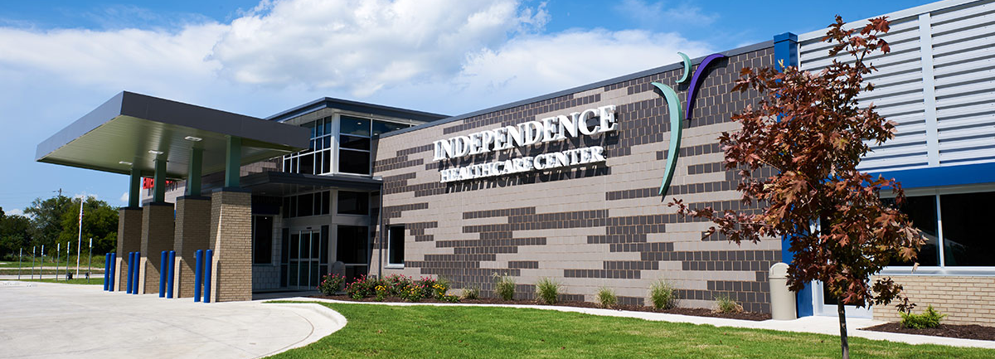
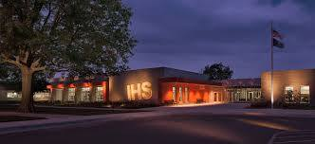
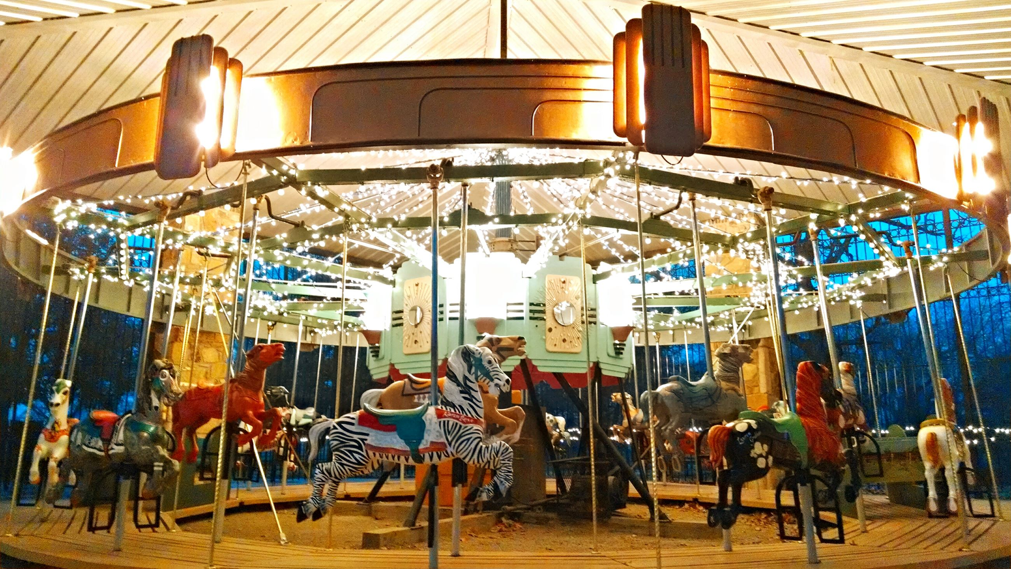
COMMUNITY
amenities
Healthcare
Housing
Daycare
Education
Grocery stores
Recreational venues
Dining and experiences
WHAT NEEDS TO BE IN PLACE ALREADY?
Notes:
As we mentioned before, a community needs to be aware of the amenities it can market in providing to aid in a developer move to the location. These amenities are (list). If there is a major deficient in one or more of these areas, the focus of the community needs to figure out a plan to fix these. Community Amenities are marketing factors that the developers use to decide if they can staff the building they build. There is a percentage of people who will come out of the community itself to work, but typically upper management positions are hired in and moved to the new locations and if there aren’t a good set of amenities to get capable management staff to move, then you may be passed up for another site location that has worse infrastructure but better amenities. A developer can always aid in the monetary side of additional infrastructure if they really want to be at your site, but aiding in gaining better healthcare or housing or even daycare for their employees is not something they digress to.

Slide 6

TIMELINE AND COSTS
FINAL PRODUCT
MARKETING BROCHURE (SINGLE OR Multi-page options)
Site layout with building
Example construction plans
4-6 week turnaround
Starting cost of $5000
RELATED TO ARCHITECTURE FEE
Notes:
After all of this talk, you are probably wondering what the timeline and cost impacts to you are for our services. As I mentioned before, we tailor our packages to each communities needs. However starting costs of our packages run at $5000 and go up from there. This rate gets you a two pages of marketing brochures, a 3 page set of construction documents of the spec building, as site layout / visual and 3 colored building renderings. The next few slides will show you what we can provide for your Virtural Spec Building package.

Slide 7
Construction documents
Spec building drawings
Notes:
At Echelon, we have a pool of industrial manufacturing buildings, as well as other types, that we can pull from to fit the need of your marketing plan. We use buildings that have already been built, or conceptualized to keep the cost of design down for your spec building package. Remember, the goal is to create something for a developer to visualize. The developer will decide what type and size of building they want to construct, but if we can provide them a visual to show a size of lot and building for that site, it helps them to visualize their selves in the space. We take one of our stock plans that you select and fit it on your site and adjust the parking and lot amenities to fit, but the building design is already complete. We will show the floor plans, site plan, building elevations and any other important information that you may want to highlight.

Slide 8
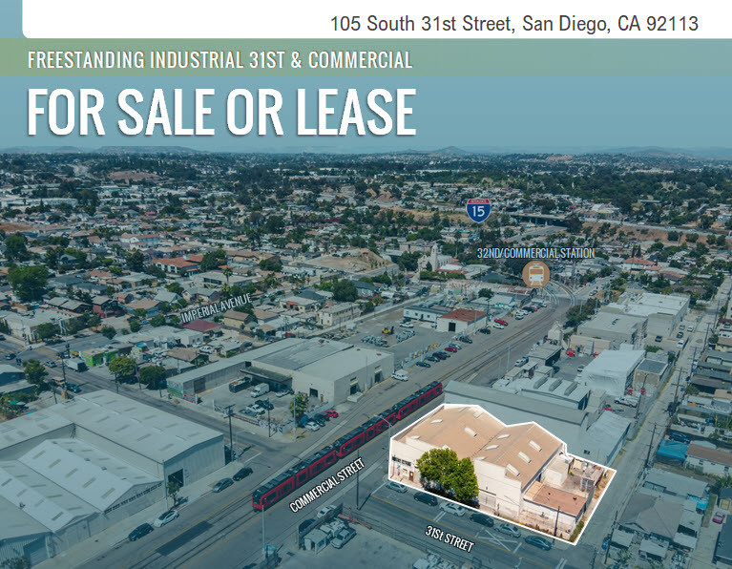
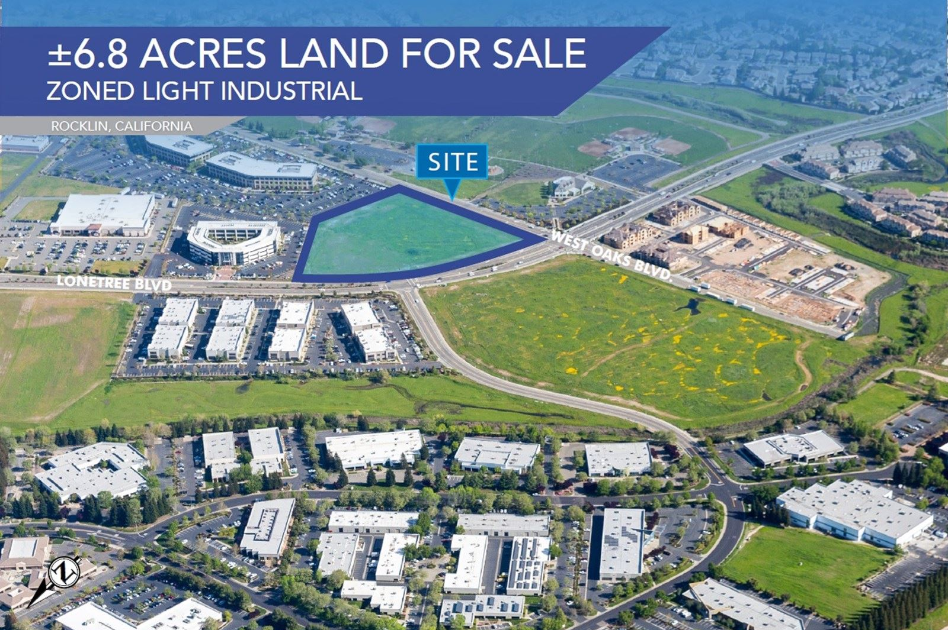
Site layout / visual
2d or 3d options
Notes:
Echelon will provide a colored google earth imagery of your site with size and location clearly labeled. This type of visual gives the developer a good idea of the road access to and from their lot as well as what might be around the lot in relation to other buildings and open area for expansion. We also like to provide a 3D conceptual visual of the site to give more context to the areas.

Slide 9
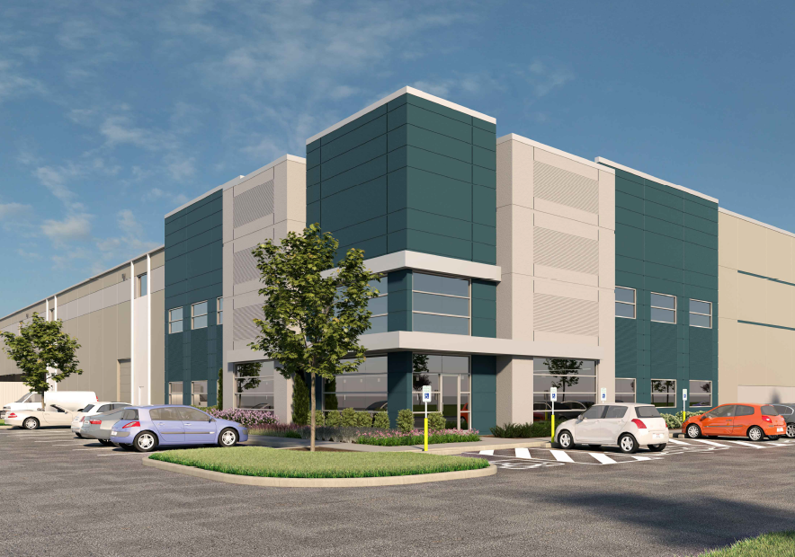
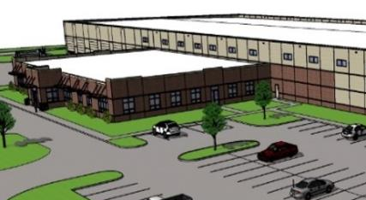
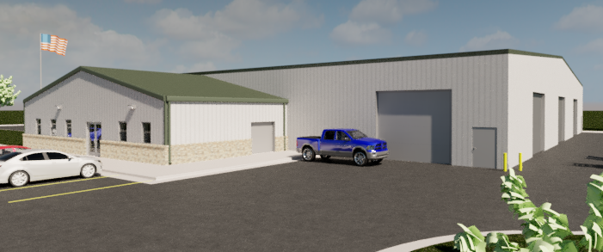
Building renderings
For social media marketing
Notes:
Colored Building Renderings are key in ensuring that you provide a visual for interested parties. There are multiple levels of quality in our rendering capabilities. The level of quality will be reflected in our fee structure. As you can tell, the top right image is the lowest quality, but it still provides a good visual. The lower right is mid quality and the left image is a high quality rendering with realistic vegetation and people interacting with the space. Echelon will provide 3 color rendered images as part of your base package that you can use for marketing materials and social media posting.

Slide 10
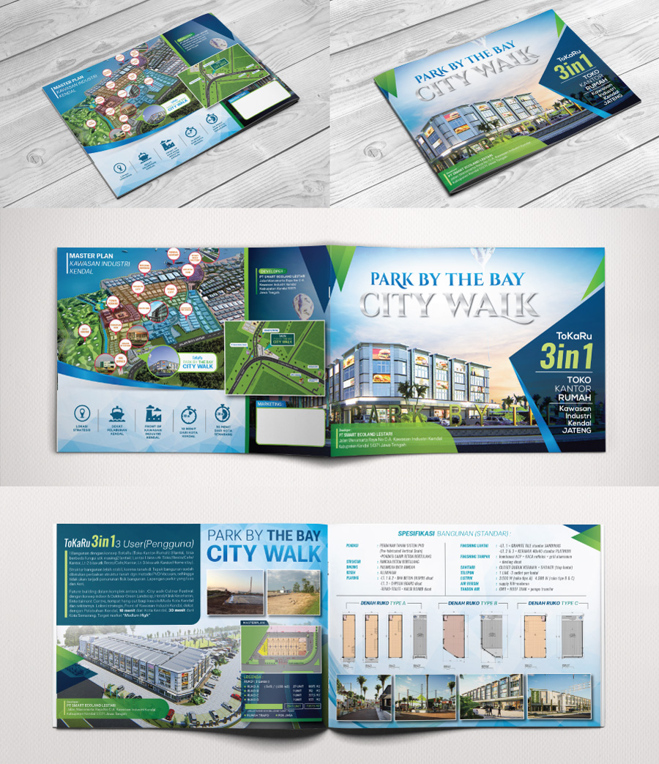
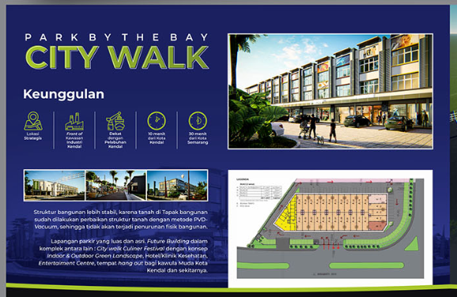
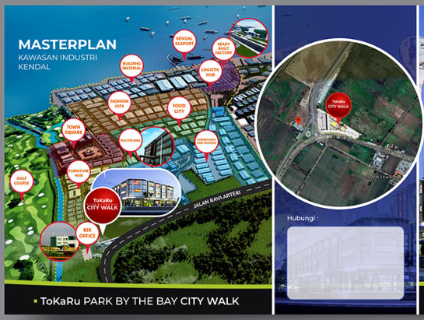
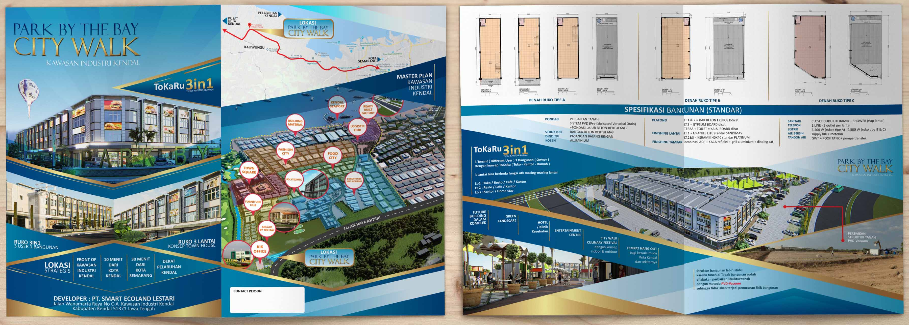
Marketing brochures
Examples for visuals only - Not prepared by echelon
Single and multi-page options
Notes:
The marketing brochures combine all of the documents, renderings, and site visuals we create into one easy handout. We can provide various types that highlight key points for the location. Single page brochures can be used for quick key point touches. We generate multi-page brochures for sales documents and more in depth informational depictions. All brochures will be provided in digital format with releases to use them as you need.

Slide 11

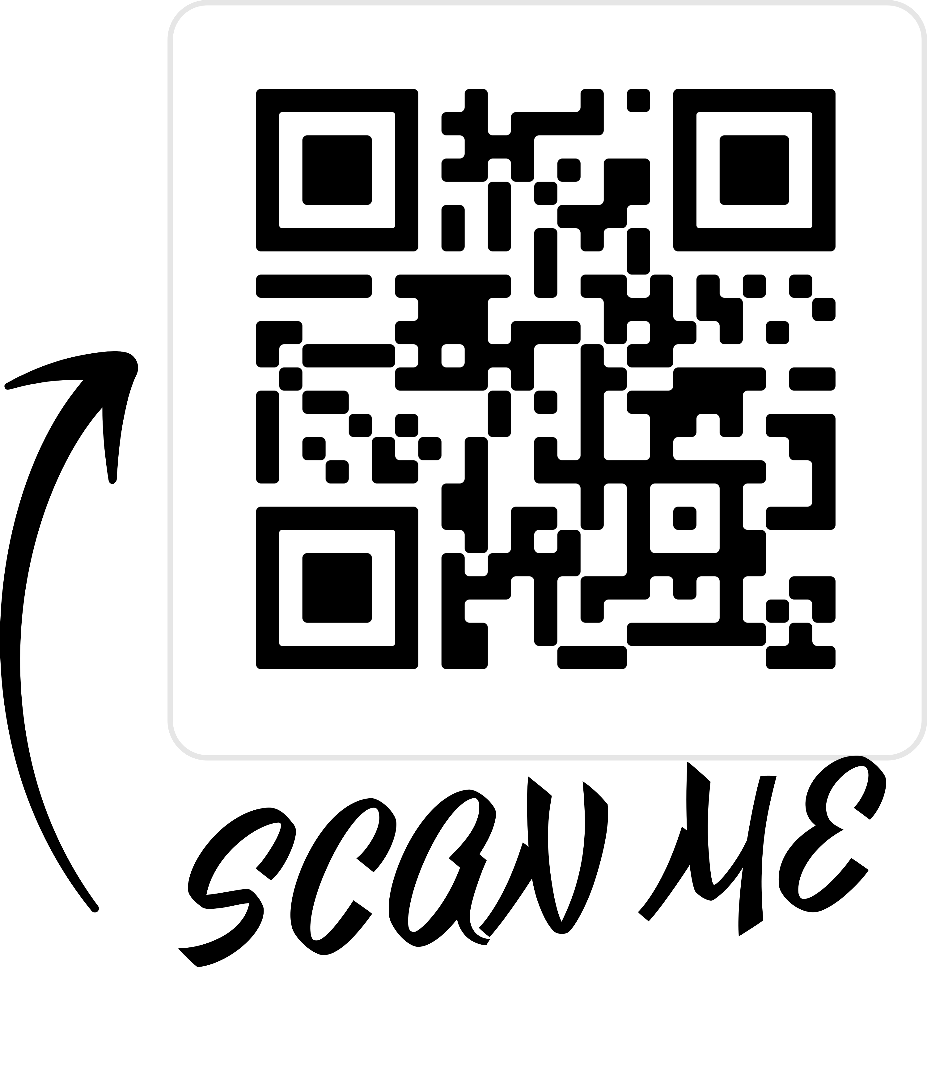





Miranda Bruening, NCIDQ
Partner | Project Manager
Cell: 620-205-8487
Office: 620-577-9300
Miranda@EchelonAD.com
Notes:
I want to thank you for allowing me to present our version of a Virtual Spec Buidling Package. We would love to help any of you interested in developing a site in your community. Please feel free to reach out to me via phone or email if you have any questions.

