Slide 1

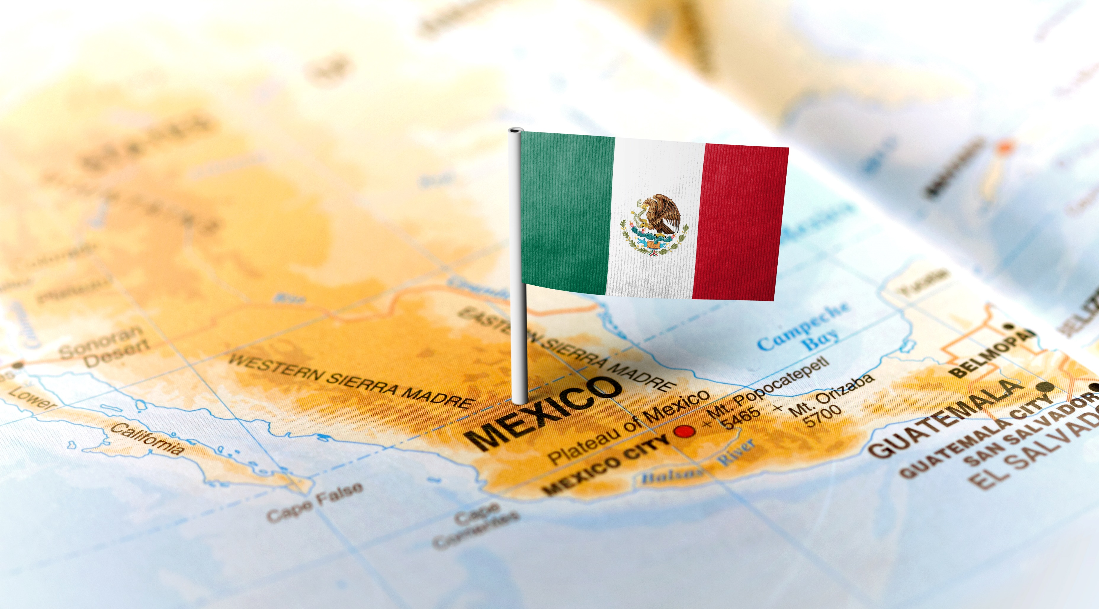


KANSAS DEPARTMENT OF COMMERCE Kansas Mexico Office & Mexican Market Overview

Slide 2

KANSAS MEXICO OFFICE
Your Local Partner in Mexico

Slide 3
ABOUT US
KANSAS MEXICO OFFICE
Your Local Partner in Mexico
Business Development Partners, S.A. de C.V.
Mexico City-based market research and trade support services company
Founded in 1994
Provides services throughout Mexico and in Central America

Slide 4
ABOUT US
KANSAS MEXICO OFFICE
Long-time Partner of Kansas Dept. of Commerce
Kansas representatives in Mexico since 2001
Over 200 projects for nearly 200 Kansas companies
Six trade missions including Governor and Vice Governor missions
Working closely with Chang Lu at KDOC since 2013

Slide 5


KANSAS MEXICO OFFICE
Your Local Partner in Mexico
Services:
Customized market research
Business partner searches
Information on market sectors and business practices
Regulatory research
Meetings arranged with local companies
Services tailored to your needs
Changes made since 2020:
Transformed all in-person activities to virtual activities

Slide 6
KANSAS MEXICO OFFICE
Example: Business Partner Search
Client requests candidates to import and distribute their products in Mexico
KMO researches candidates, discusses client business opportunity with them, chooses best candidates and presents findings in report
Contact information and brief profile of each candidate plus any relevant market information acquired
We can assist in establishing contact with candidates if necessary

Slide 7
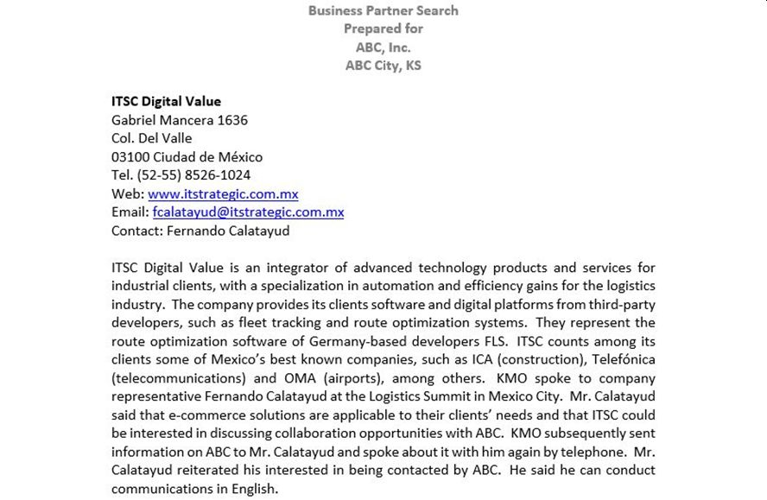

Slide 8
KANSAS MEXICO OFFICE
How To Carry Out A Project
Contact the Kansas Department of Commerce
Mexico Office Manager, Mr. Chang Lu
Submit a Service Request Application
Conduct conference call with the Mexico Office
Receive the finished report
Communicate with identified Mexican partners
Contact the Mexico Office Manager for any communication issues or further assistance

Slide 9
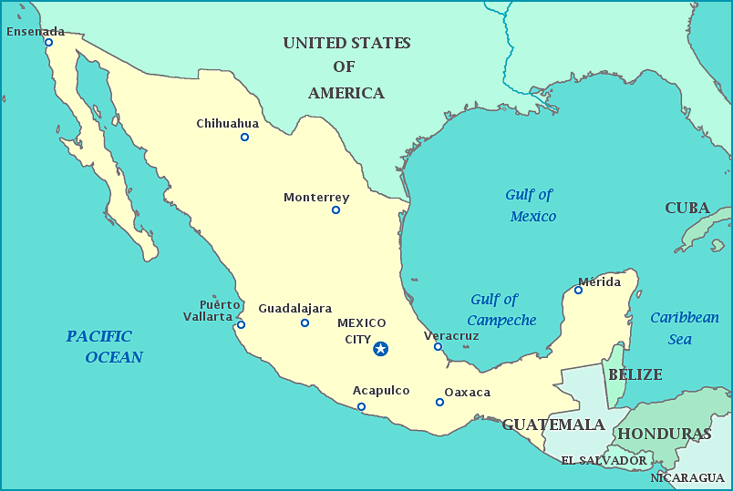
Mexico: Location and Geography

Slide 10
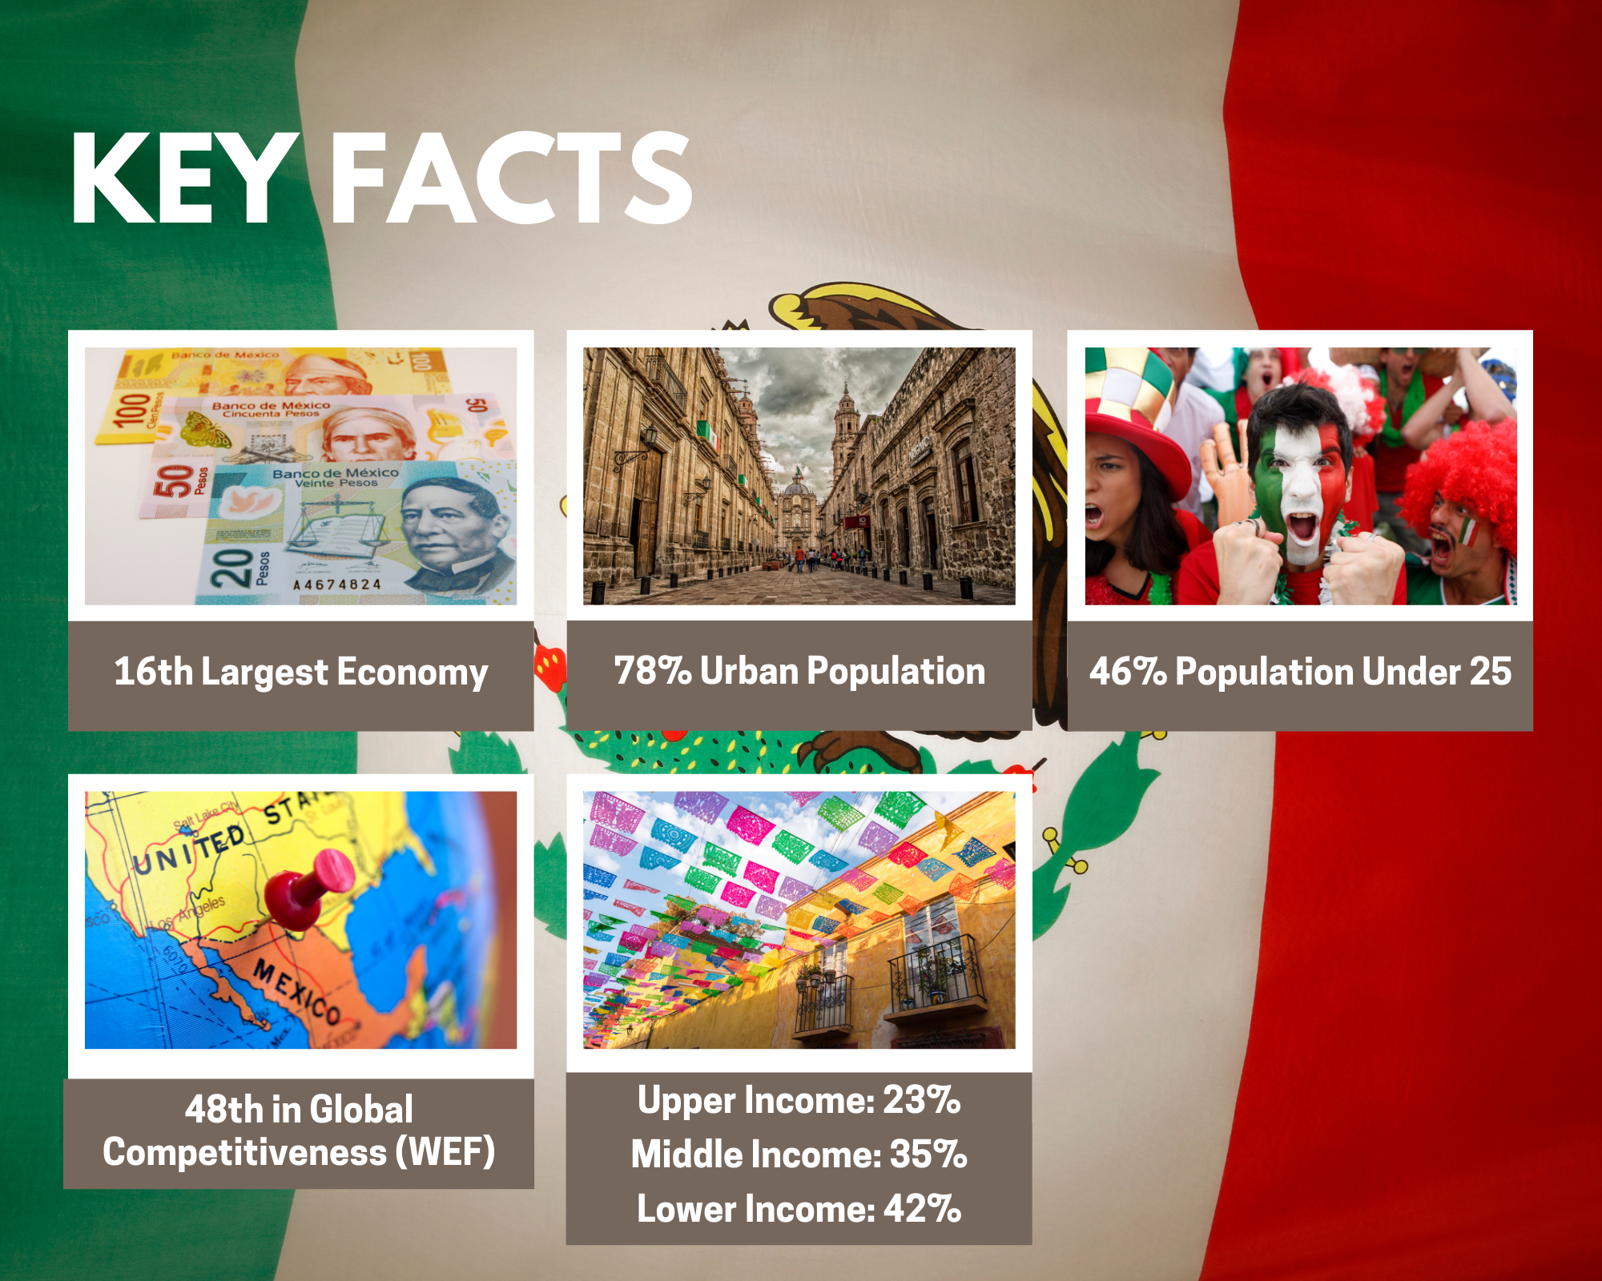
MEXICO SNAPSHOT
Population: 130 million (est. U.N. 2021)
U.S. Exports to Mexico: $276 billion (2021, U.S. Census)
GDP per capita (PPP): $18,444 (2020, World Bank)
GDP growth: 4.8% (2021, INEGI)
Projected 2022 growth: 2.4% (Banxico)
Unemployment rate: Aprox. 4% in 2021 (INEGI)
Remittances of $51 billion in 2021 (Banxico)

Slide 11
MEXICO is a Larger U.S.
Export Market Than China

Slide 12
USMCA Free Trade Agreement
Entered into effect July 2020 to replace NAFTA
$1.8 billion a day in U.S.-Mexico goods trade in 2021
Enormous integration of supply chains between Mexico and USA
Major Mexican industries depend on equipment and raw materials from the USA
Duty-free HTS classifications under NAFTA remain duty free under USMCA
USMCA increases regional content requirement for key industries

Slide 13
MEXICO
Kansas’ Top Export Market in 2021
Kansas’ largest export market, no. 1 in 2021
(Followed by Canada, China, Japan, South Korea)
$2.7 billion in Kansas exports to Mexico
(Total trade $3.5 billion)
Agricultural products top Kansas exports to Mexico
($1.9 billion in 2021)
$249 million in aircraft and parts
$72 million in electric machinery
$87 million in industrial machinery
Source: WISER trade database

Slide 14
KEY INDUSTRIES
Energy: Oil, gas, electricity, renewables
Automotive manufacturing
Aerospace manufacturing
Tourism
Food and beverage processing
Agriculture
Mining
Chemicals
IT services: Software, data services, call centers

Slide 15
COVID-19 Impact on the Economy
Mexico experienced severe economic downturn in 2020 and is still in the process of recovery.
Mexico suffered 8.2% contraction of economy in 2020
Economy projected to return to 2019 levels by 2023 - 2025
Supply chain problems severely affected manufacturing industries
Government avoided stimulus and job protection programs

Slide 16
Current State of COVID-19
The most recent spike in new cases ocurred in December and January and has declined since then.
Restrictions on economic activity and mobility are low
Masks are required for entering businesses in most áreas
No timeline for lifting mask mandates in Mexico City
Work-from-home and hybrid models remain in effect for many businesses where possible
In-person business meetings depend on individual criteria

Slide 17
Public Policy Environment
Current government is different from any other in recent decades
President Andrés Manuel López Obrador (AMLO) is called a leftist
Government is not “Business friendly”
Seeks state and military control over activities formerly in the private sector

Slide 18
New State Role in the Economy
Energy:
Government shifting oil production from private companies to Pemex
New focus on oil refining and reducing crude exports
Electricity returning to state monopoly CFE
Solar and wind energy facing increasing obstacles
Military now operating new capital airport, passenger train, ports, medicine distribution, Customs operations, public safety
New state enterprises in banking, LP gas distribution, healthcare

Slide 19
2024 Presidential Election
AMLO will try to assure that his “movement” will continue
Current frontrunners:
Claudia Sheinbaum: Mexico City mayor and AMLO sycophant
Marcelo Ebrard: Foreign Secretary and more progressive
What path will Mexico follow after 2024?

Slide 20

CONTACT: Chang Lu (913) 515-8541 Cell Chang.Lu@ks.gov

