Slide 1
Wichita, Kansas Conference
CE Mark and EU Environmental
Regulations
January 19, 2022

Slide 2

CE Marking: Passport to Selling in the EU Single Market

Slide 3
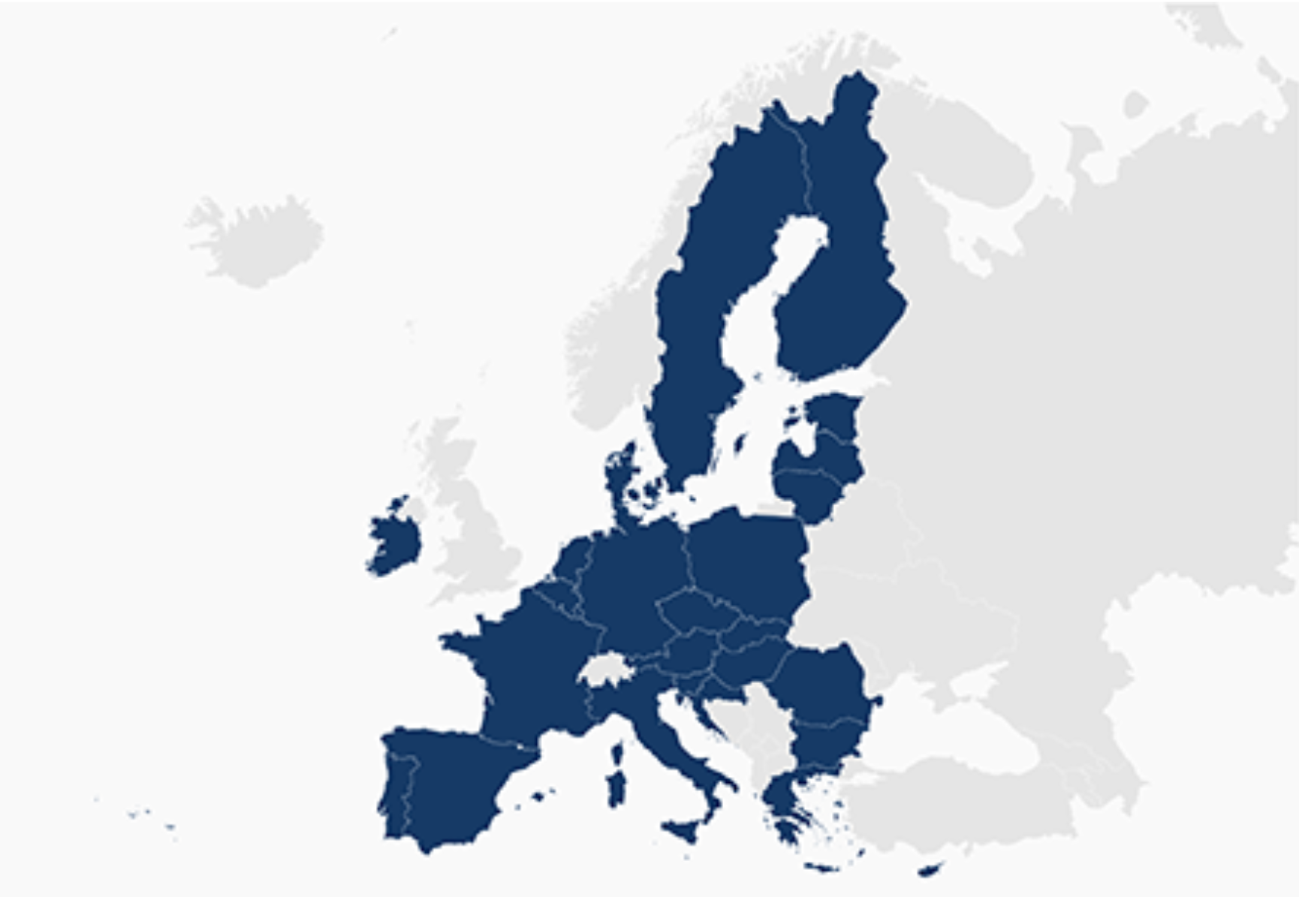
= CE Marking
CE Marking
https://freevectormaps.com/world-maps/europe/WRLD-EU-01-0004?ref=atr

Slide 4
CE Mark Overview
EU Single Market program calls for freedom of goods, services, people and capital.
CE Mark program is the cornerstone of the freedom of goods part of the Single Market. The CE mark shows a product has attained a minimum level of safety to protect EU workers and consumers across the 27-nation EU.

Slide 5
Old Approach vs. New Approach
Old Approach (pre-CE)-- Directives covering specific sectors like autos, chemicals and cosmetics.
Were seen as too slow to adopt for purposes of forming the Single Market.
New Approach (post- CE)--Directives taking a horizontal approach, such as the Machine Directive, which covers all types of machinery.
These directives are all- inclusive and lend themselves better to the Single Market

Slide 6
CE Mark Legislation
Directives (laws) and regulations make up the core of the CE mark program.
These directives and regulations are proposed by the European Commission, amended by the European Parliament, and approved by the Council of Ministers.
U.S. companies have input into this system through both the Parliament and Commission.

Slide 7
CE Mark Legislation
Directives and regulations provide the legal basis for CE mark (health and safety) requirements, but standards supply the technical information for meeting CE mark requirements.
U.S. companies have a far greater chance of commenting on the development of the directives than they do on shaping the standards. (Need to have a manufacturing presence in Europe to comment on standards).

Slide 8
EU Standards Organizations
CEN – European Committee for Standardization
---Machinery, Medical, Pressure Equipment Personal Protective Equipment and others
CENELEC – European Committee for Electrotechnical Standardization
---Electrical products falling under EMC, Low Voltage, Medical/electrical, and some others
ETSI--European Telecommunications Standards Institute – Mostly Radio Equipment Directive products

Slide 9
What U.S. Exporters Need to Know
Key CE Mark Directives
Machine Safety
Radio Equipment Directive
Electromagnetic Compatibility
Low Voltage
Medical Device
In Vitro Diagnostic Medical Device
Recreational Craft
Pressure Equipment
Simple Pressure Vessels
Toys
Restriction of Hazardous Substances
Energy Related Products
Construction Products
Non-Automatic Weighing Devices

Slide 10
What U.S. Exporters Need to Know
Key Terms You’ll Learn About Today
-- Technical File
-- Risk Assessment Report
-- Conformity Assessment
-- Declaration of Conformity
-- EU Enforcement/Surveillance

Slide 11
Technical File
The technical file must show that the product meets the requirements of the directive. That includes the risk assessment report which would be on top.
It must cover design, manufacture, and operation of the product and will include designs, test reports and certificates.
The technical file must be written in one of the official Community languages except for the operating instructions (which has to be in the language of the user) and must be available for 10 years after the machine has been put on the market.

Slide 12
Technical File
Technical file provides proof of CE mark compliance to EU enforcement authorities if they question the product.
Authorized reps (for medical devices) and European reps (for machinery) will insist on seeing the manufacturers technical file.

Slide 13
Risk Assessment Report
The risk assessment report is included at the beginning of the technical file. Risk assessment is referenced in the machine, Pressure Equipment, Medical Device Directives and in the EMC and Low Voltage standards.
The risk assessment for the Machine Directive consists of:
--The protective measures employed to eliminate or reduce identified hazards and, where these hazards can’t be completely eliminated, the ways of warning the user about residual risks.

Slide 14
Risk Assessment Report
Use of warning signs and guards are ways to offset residual risk.
The risk assessment standard for the Machine Directive is EN 12100:2010; the risk assessment standard for the Medical Device Directive is EN 14971:2019.

Slide 15
Conformity Assessment
Conformity assessment is the process carried out by the manufacturer to show that the product has met appropriate CE mark directives.
How to Determine Conformity Assessment
--Which CE mark directives cover the product?
--Some directives, such as the Machine Directive, allow for ‘self-certification’ in most cases by
meeting the ‘essential health and safety requirements’ seen in Annex I of the Machine Directive.
Internal production control module

Slide 16
Conformity Assessment
--Other products, such as Class II or III medical devices, certain kinds of personal protective equipment, or pressure equipment,
must be certified and approved by a notified body in Europe because these products are too risky.
(known as type approval)
--There are labs in the US that sub-contract with the EU notified bodies so testing can be done in the
U.S. for these higher risk products.

Slide 17
Conformity Assessment
Manufacturers de-facto have to use European standards to certify for the EMC and Low Voltage Directives and need to confirm this with a test result from a lab. The lab does not have to be affiliated with a notified body but has to be accredited.
SME’s top complaint about the CE mark program is the expense associated with these lab tests.

Slide 18
Declaration of Conformity and CE Marking
The Declaration of Conformity (DOC) is a sheet of paper that accompanies each shipment and tells EU customs that the product has met CE mark requirements.
The CE mark must be affixed near the name plate of the manufacturer and must be at least 5 mm. The name of the importer is also supposed to be on the product packaging or on the DOC.

Slide 19
Sample Declaration of Conformity
(Upper left hand corner) Manufacturer: Jones Printing Press 325 Grassy Knoll
Garden City, New York Telephone No. (516) 555-3333
Product: Printing Press Model No. 3.5L
Serial Number 350000 - 360000

Slide 20
Sample Declaration of Conformity
The undersigned hereby declares on behalf of Jones Printing Press of Garden City, N.Y., that the above referenced product, to which this declaration relates, is in conformity with the provisions of:
--Machine Safety Directive (2006/42/EC)
--Electromagnetic Compatibility Directive (2014/30EU) Standards Used
--EN 12100:2010 (risk assessment)
--EN 60204-A1 – 2009 (electrical safety)
--EN 61000-6-2:2005 (immunity)
-- EN 61000-6-4:2007 (emissions)

Slide 21
Sample Declaration of Conformity
The technical file is kept at the corporate headquarters of Jones Printing Press, 325 Grassy Knoll, Garden City, N.Y.
_ _ __
Joseph P. Glass
Vice President – Design Engineering Name and contact information of European Representative (to meet requirements of the Goods Packaging Regulation, 2019/1020)

Slide 22
Market Surveillance
New Legislative Framework (NLF) of 2008 was put in place to strengthen market surveillance, forcing each member state to set up a CE mark enforcement division.
CE mark surveillance has tightened considerably since 2008. The NLF makes the manufacturer, importer and distributer responsible for CE mark compliance.

Slide 23
New Legislative Framework-- NLF
The NLF consisting of one regulation (2008/765) and one decision (2008/768), strengthened the CE mark program by making the entire supply chain responsible:
--Manufacturers
--Importers
--Authorized reps
--Distributors

Slide 24
New Legislative Framework -- NLF
--Each part of the supply chain has its responsibility to make sure a product is CE mark compliant.
--European market surveillance people now have people in Europe to hold responsible. Before, did the EU have the legal authority to chase down a manufacturer in the U.S. or some other non-EU country? Doubtful.

Slide 25
New Legislative Framework -- NLF
--NLF Regulation 2008/765 was about market surveillance and accreditation.
--Instructed member states to set up market surveillance agencies, and
--Set up a single accreditation body in each member state to accredit notified bodies and conformity assessment bodies

Slide 26
Market Surveillance and Compliance Regulation, 2019/1020
This is a further evolution of the EU’s enforcement program.
--Article 4 states that all companies doing business in Europe are economic operators and must be represented by:
--the manufacturer
--the importer (could be a distributer)
--an authorize rep
--a fulfillment center

Slide 27
Market Surveillance and Compliance Regulation, 2019/1020
As a result of Article 4, the EU market surveillance authorities will have the means by which to contact a representative from any company making a product doing business in Europe
This regulation applies to virtually all CE mark directives

Slide 28
Other CE Mark Issues
The Manufacturer
The manufacturer is the person whose name appears on the product. The person putting his/her brand name or label on a final assembled product is now the manufacturer and is responsible for meeting CE mark requirements.
When subcontracting takes place, the manufacturer is still responsible for CE mark requirements.

Slide 29
Other CE Mark Issues
European Standards
Use of European standards confers a presumption of conformity on those products the EU standards apply to. Use of European standards is voluntary but is de facto mandatory for products covered by the Electromagnetic Compatibility (EMC) and Low Voltage Directives.
Components – As a rule, components by themselves don’t need the CE mark but need to be assessed as part of a complete unit for CE mark requirements.

Slide 30

Steps to CE Marking
Step 1: Identify applicable directives and standards
Most Difficult
Step 2: Assess product/machine according to all ‘essential requirements’ and standards
Step 3: Prepare the Technical File
Step 4: Prepare the EC Declaration of Conformity
Easy
Step 5: Affix the ‘CE Marking’

Slide 31
Key Links for Information
https://ec.europa.eu/growth/single-market/European-standards/harmonized-standards_en
This link has the EU CE mark directives and list of standards. Some important non-CE mark directives such as for chemicals and cosmetics are also included.
http://trade.gov/ce-marking
This link has a list of accredited labs in the U.S. that can do testing and certification for CE mark directives. Consultants who can help companies get the CE mark are also shown.

Slide 32
General Product Safety Directive (2001/95/EC)
This directive is sometimes called “CE mark catch-all directive”
--It covers products where safety is an issue but where no CE mark directive has been adopted. Examples:
--furniture, gymnastics equipment, roller blades, infant car seats and many others

Slide 33
EU Environmental Directives
Three Main Directives for Discussion Here
Restriction of Hazardous Substances Directive (RoHS) (2011/65/EU)
Energy Related Products Directive (ErP) (2009/125/EC)
Waste of Electrical and Electronic Equipment (WEEE)(2012/19/EU)

Slide 34
Restriction of Hazardous Substances Directive
--Applies to electrical and electronic equipment
--Restricts the use of 10 substances including lead, mercury, cadmium, hexavalent chromium, two flame retardants and four phthalates

Slide 35
RoHS --Continued
--Manufacturers will need to be in touch with their supply chains to make sure the materials and parts they’ve sold to the manufacturer are RoHS compliant
.
--RoHS exclusions include large scale stationary industrial tools, large scale fixed installations, and non-road mobile machinery for professional use

Slide 36
RoHS Directive--Continued
RoHS is a CE mark directive. The manufacturer will have to put together a technical file showing how it complied. The RoHS Directive will also have to be listed on a declaration of conformity.
The EU is enforcing RoHS so companies need to make sure they can prove they’ve met the requirements.

Slide 37
Energy Related Products (ErP)
ErP is mainly about energy efficiency requirements but there are some resource requirements (such as how much water and washing machine can use).
ErP mostly covers electrical and electronic products but non-electric products like tires are covered. Glass windows might be covered in the future.

Slide 38
Energy Related Products--Continued
Examples of Products Covered by ErP
--Lighting --Washing Machines
--Heating --Air Conditioners
--Refrigeration --Kitchen Appliances
--Vacuum cleaners --TV boxes

Slide 39
ErP --Continued
There’s a separate regulation for each product covered by ErP. All the requirements are contained in the regulation.
ErP is a CE mark directive and a company can ‘self-declare’ by meeting the requirements of the regulation. Will need to put together a technical file.

Slide 40
RoHS and ErP (Continued)
The RoHS Directive applies horizontally to all electrical and electronic equipment.
The ErP (Energy Related Products) Regulations are aimed at specific products. There’s regulations for washing machines, computers, servers, driers, and about 20 or so other products with more in development.

Slide 41
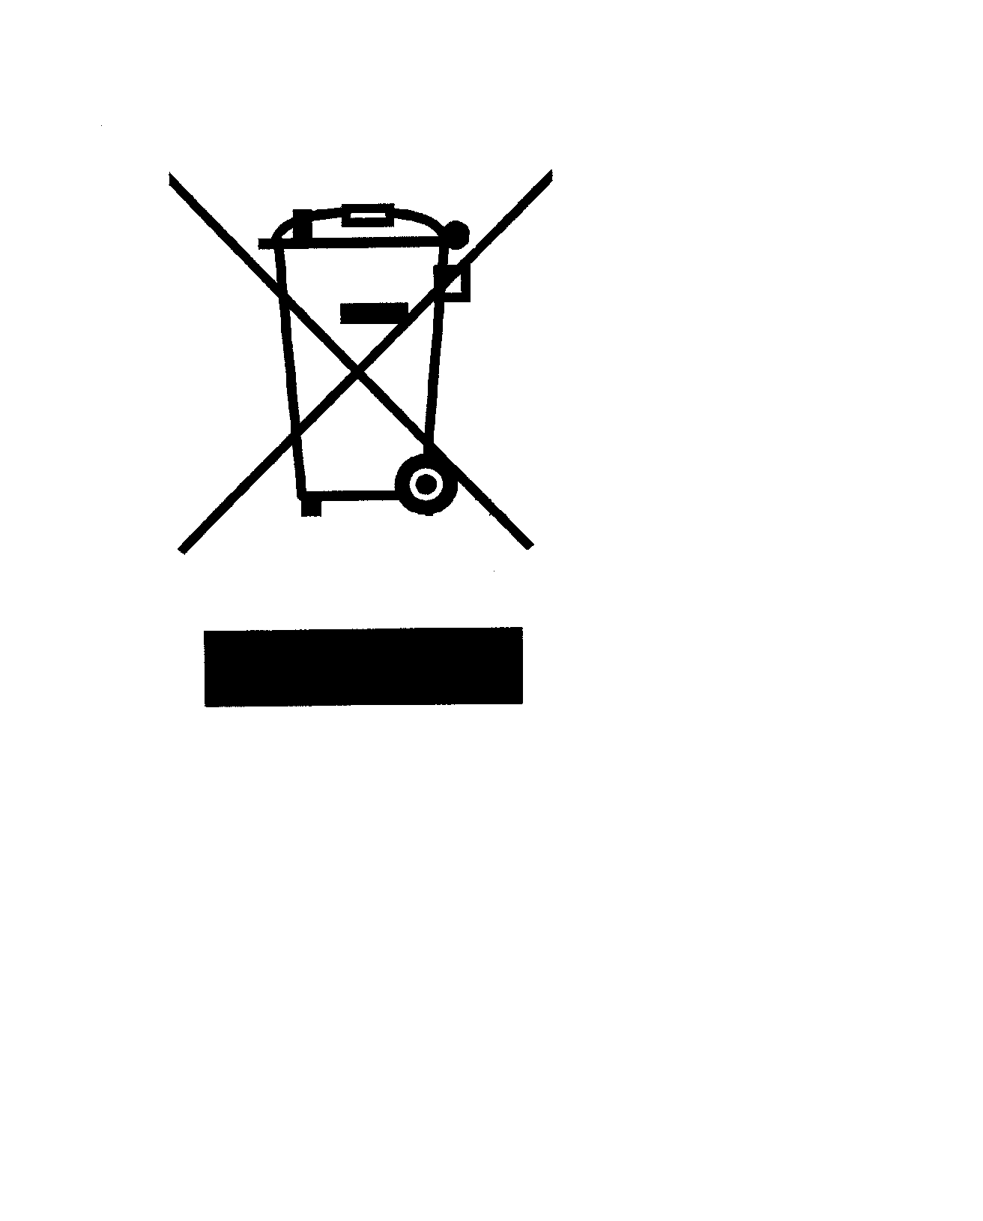
WASTE OF ELECTRICAL AND ELECTRONIC EQUIPMENT (WEEE)
EN 50419 –
Companies affix WEEE insignia to their product
--Effective August 2005

Slide 42
Waste of Electrical and Electronic Equipment (WEEE)
Usually the customer in Europe takes care of the WEEE requirements.
The WEEE directive is essentially a mandatory recycling directive for electrical and electronic products in Europe.
The directive involves registration, reporting and recycling. (not a CE mark directive)

Slide 43
Conclusion
About half of all US exports to Europe are covered by the CE mark.
The cost of lab test results, esp. for the EMC and Low Voltage standards, are the biggest drawback for SME’s.
But the CE mark does allow access to a lucrative market of 500 million plus.
Please be aware of changes if you get involved in exporting, such as Machine Directive, RoHS, and standards

Slide 44
Contact for CE Mark Information
Bob Straetz
Office of Western and Northern Europe GM/ITA
Tel: 202-923-5411
Robert.straetz@trade.gov

