Slide 1

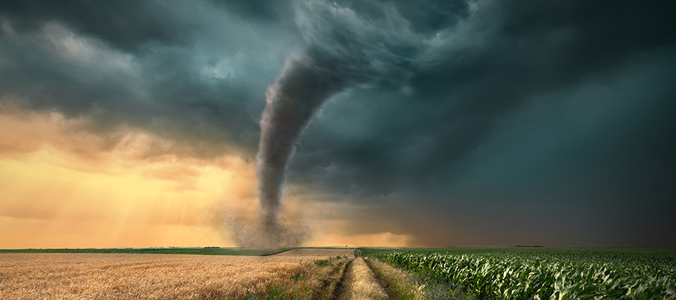
CDBG Urgent Need

Slide 2
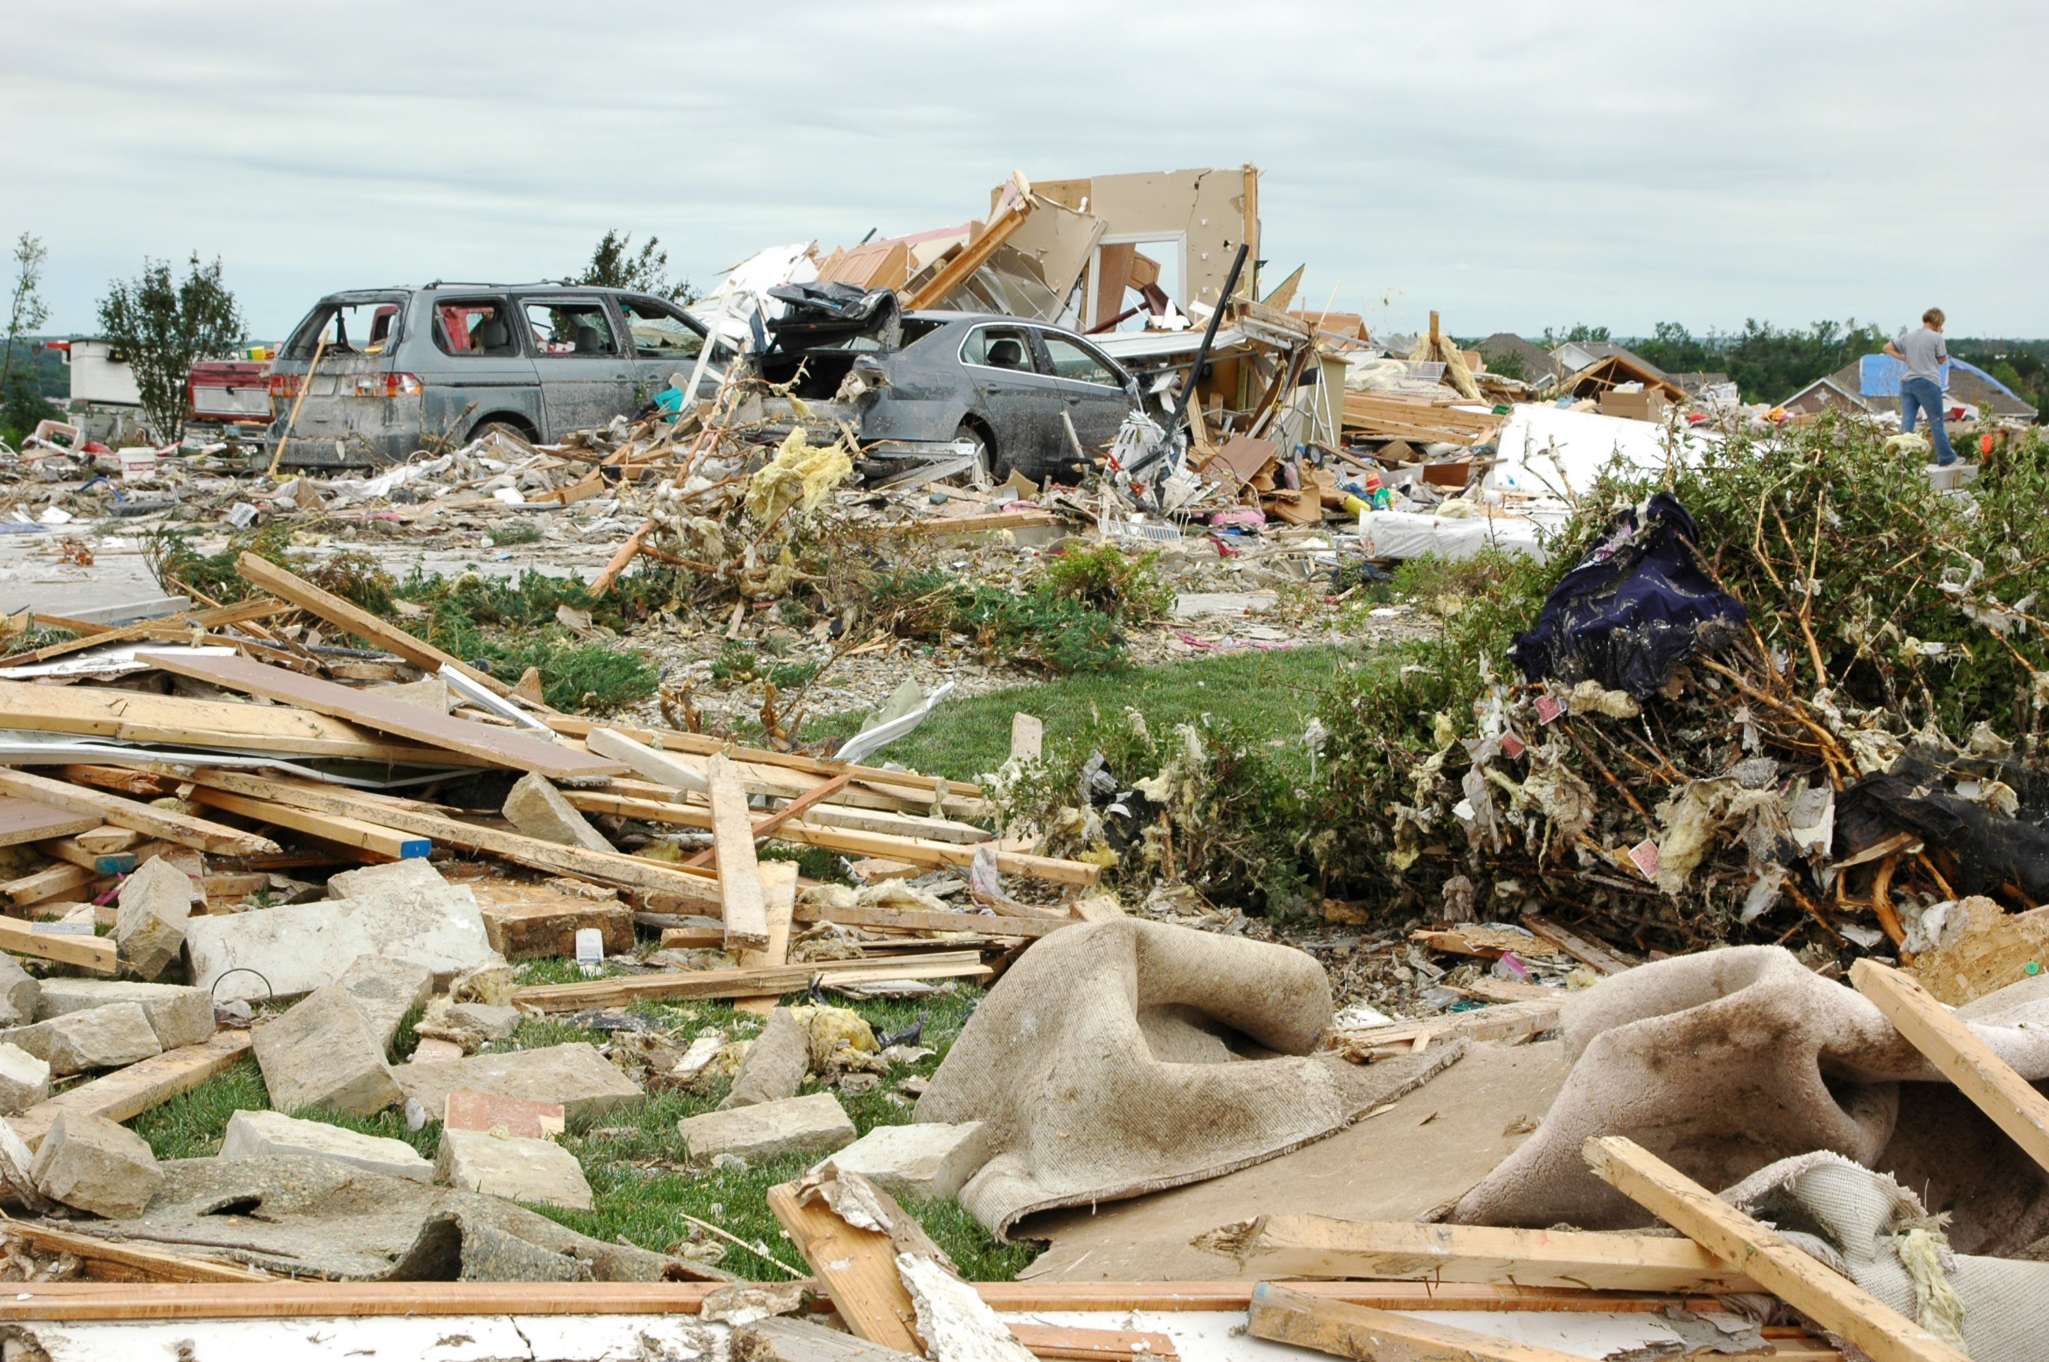

CDBG Urgent Need
In very limited situations as last resort funding
Examples:
1. Acquisition of property located in a flood plain that was severely damaged by a recent flood
2. Public facility improvements like the reconstruction of a publicly-owned hospital that was severely damaged by a tornado
3. Demolition of structures that are severely damaged by a major earthquake
4. Interim assistance such as emergency treatment of health problems cause by a flood
5. Special economic development assistance to a grocery store that was damaged by an earthquake.
Urgent Need Projects are last resort funding

Slide 3
Funding Criteria
Max grant amount is $400,000
Must be of recent origin within the last 6 months following a disaster
Certified urgent- a risk to health and safety by an agency that has jurisdiction over said condition
Only the immediate emergency will be addressed
No temporary solutions only complete solutions
No other funding sources available

Slide 4
Application
Applications are accepted until December 3rd, 2021
The applications will be submitted online at
CDBG Urgent Need Grants | Kansas Department of Commerce (kansascommerce.gov)

Slide 5
THANK YOU
Ginny Eardley
CDBG Project Manager
Ginny.M.Eardley@ks.gov
www.KansasCommerce.gov

