Slide 1


State of Kansas Vietnam market briefing
Ryan Hollowell, COMMERCIAL Officer
U.S. Commercial Service Vietnam

Slide 2
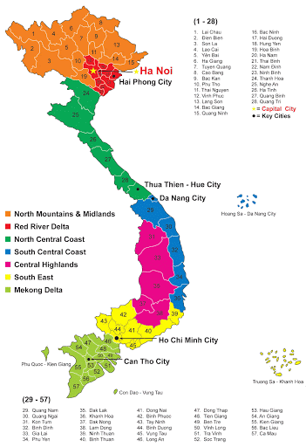
Vietnam @ a glance
  Population: 97 million (2020 est.), ranked 15th
  71% of total population<65 years
  Total area: 331,000 sq km,
  Ranked 67th in the world, slightly larger than NM, but smaller than MN.
  GDP: $241.3 billion (2018); ranked 6th in ASEAN
  GDP real growth rate: 6.5% (2019 est.); 7.1% (2018); 6.8% (2017)
  Per Capita GDP: $2,730 (2019 est.); $2,551 (2018); ranked 8th in ASEAN
  Poorest country in the world in 1990s to become a lower middle-income country with per capita income over $2,000.
  Fastest growing economy in ASEAN, on par with China
  Rapidly growing middle-class consumers – which spurs demand and increasing opportunities in many sectors – healthcare, education, services
  Source: IMF
  ITA

Slide 3
Vietnam Market Overview Country Snapshot
Vietnamese living in extreme poverty fell to a mere 3% by 2012, down from half the population in the early 1990s. (source: World Bank)
HCMC is the economic engine of the country – 10% GDP growth in 2016.
HCMC is key region for Vietnam’s inward FDI, manufacturing and export activity.
Source IMF © Statista 2019 | Additional Information Vietnam, IMF
U.S. Department of Commerce - International Trade Administration - U.S. Commercial Service
Notes:
Source link: https://www.statista.com/statistics/444616/gross-domestic-product-gdp-growth-rate-in-vietnam/
Or simply Google: Vietnam: Growth rate of real gross domestic product (GDP) from 2015 to 2025*

Slide 4
Vietnam Market Overview Country Snapshot
Middle class expected to double by 2020 – accounting for 50% of the population. (source: Boston Consulting Group)
Affluent class is growing faster than any economy in the world. (source: Knight Frank’s Wealth Report)
7% increase in consumer spending. (source: BMI Research)
Opportunities for U.S. education, travel/tourism, franchising and consumer goods.
Source IMF © Statista 2019 | Additional Information Vietnam, IMF | * middle class: people with income of $8,000-35,000/year
U.S. Department of Commerce - International Trade Administration - U.S. Commercial Service
Notes:
Source link: https://www.statista.com/statistics/444743/gross-domestic-product-gdp-per-capita-in-vietnam/
Or simply Google: Vietnam: Gross domestic product (GDP) per capita in current prices from 1985 to 2025*

Slide 5
U.S. Trade with Vietnam
Year | Exports | Imports | Balance
2020 | 9,042.9 | 72,723.9 | -63,680.9
2019 | 10,860.5 | 66,629.9 | -55,769.5
2018 | 9,675.6 | 49,158.6 | -39,483
2017 | 8,133.4 | 46,488.5 | -38,355.1
2016 | 10,098.7 | 42,091.5 | -31,992.9
In $Billions
Source: U.S. Census Bureau, Trade in goods with VN

Slide 6
A larger context
  U.S. Withdrawal from the TPP
  China is aggressively promoting/advocating its vision for the ASEAN/Pacific region:
    One Belt One Road (OBOR)
    Asia Infrastructure Investment Bank (AIIB)
  U.S. is countering with Indo-Pacific Strategy (IPS)
  “U.S. Mission Vietnam’s goal is for the United States to be a vital partner in supporting the development of a strong, prosperous, and independent Vietnam that contributes to international security; engages in free, fair, and reciprocal trade; and respects human rights and the rule of law.”

Slide 7


The Secrets to Exporting Success
[Insert NAME], COMMERCIAL COUNSELOR
U.S. Commercial Service Vietnam
[INSERT DATE]

Slide 8
Introducing U.S. Commercial Service
An Agency within the Department of Commerce
Export Promotion Arm of the U.S. Government
A Network of over 1000 trade professionals, with more than 100 offices in the U.S., and over in over 70 countries
CS Missions:
  Promote export of U.S. goods and services
  Protect and advance U.S. commercial interests aboard (assistance in advocacy and commercial disputes)
  Promote foreign investment into the U.S.

Slide 9
How CS can help U.S. companies
U.S. Commercial Service “Core Services”
Business Facilitation
Gold Key Matchmaking
International Partner Search
International Company Profile
Single Company Promotion
Trade Promotion Events
International Buyer Programs
Trade Missions/US Pavilions
Market Research
Market Research Library
Customized Market Research
Country Commercial Guide (CCG)
Customized Programs
Advocacy
Business Consulting
U.S. Department of Commerce - International Trade Administration - U.S. Commercial Service

Slide 10
U.S. Commercial Service in Vietnam
Two offices: Hanoi, HCMC
4 American Officers
13 Local staffs
U.S. Department of Commerce - International Trade Administration - U.S. Commercial Service

Slide 11
Doing Business in Vietnam
IPS Priority Sectors/Opportunities
Aviation Energy Healthcare ICT/Smart Cities Select U.S.A
U.S. Department of Commerce - International Trade Administration - U.S. Commercial Service

Slide 12
Aviation
7th fastest growing aviation market in the world (IATA rank, June 2018)
16% annual passenger growth, 104m pax in 2018 → 131m (est.) pax. in 2020
11% annual cargo growth, 1.52m tons of cargoes in 2018 → 18%, 2.2 m ton by 2020
9% air traffic growth, 652k flights in 2018 -→ 1.5M flights by 2020
5 airlines with over 190 aircrafts
23 airports → 28 airports by 2030
U.S. Department of Commerce - International Trade Administration - U.S. Commercial Service

Slide 13
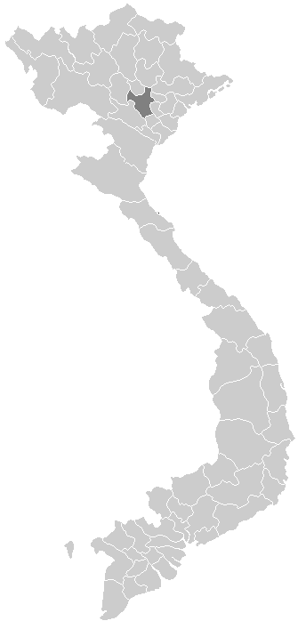
energy
HAI PHONG LNG
QUANG NINH LNG
NGHI SON LNG
Electricity of Vietnam (EVN) is the sole power purchaser and distributor.
Energy demand will increase of 10% per year through 2025 and to add more than 61GW until to 2029.
Existing energy sources: Hydro, Coal-fired, Gas-fired, Other Renewable – solar and wind.
Challenges:
  Poor Infrastructure
  Projects Bankability
  Long decision-making process
HA TINH LNG (VUNG ANG)
QUANG BINH LNG
HAI LANG LNG
QUANG TRI OFFSHORE WIND
CHAN MAY LNG
BINH DINH OFFSHORE WIND PROJECTS
BINH THUAN OFFSHORE WIND PROJECTS
MY GIANG LNG
BA RIA VUNG TAU OFFSHORE WIND PROJECT
CA NA LNG
NINH THUAN OFFSHORE WIND PROJECT
BEN TRE OFFSHORE WIND PROJECT
O MON COMPLEX
BAC LIEU LNG
MUI KE GA LNG
BAC LIEU OFFSHORE WIND PROJECT
SON MY COMPLEX
CA MAU OFFSHORE WIND PROJECT
NHON TRACH 3 & 4
LONG SON LNG
LNG Projects
Offshore Wind Projects
LONG AN LNG
U.S. Department of Commerce - International Trade Administration - U.S. Commercial Service

Slide 14
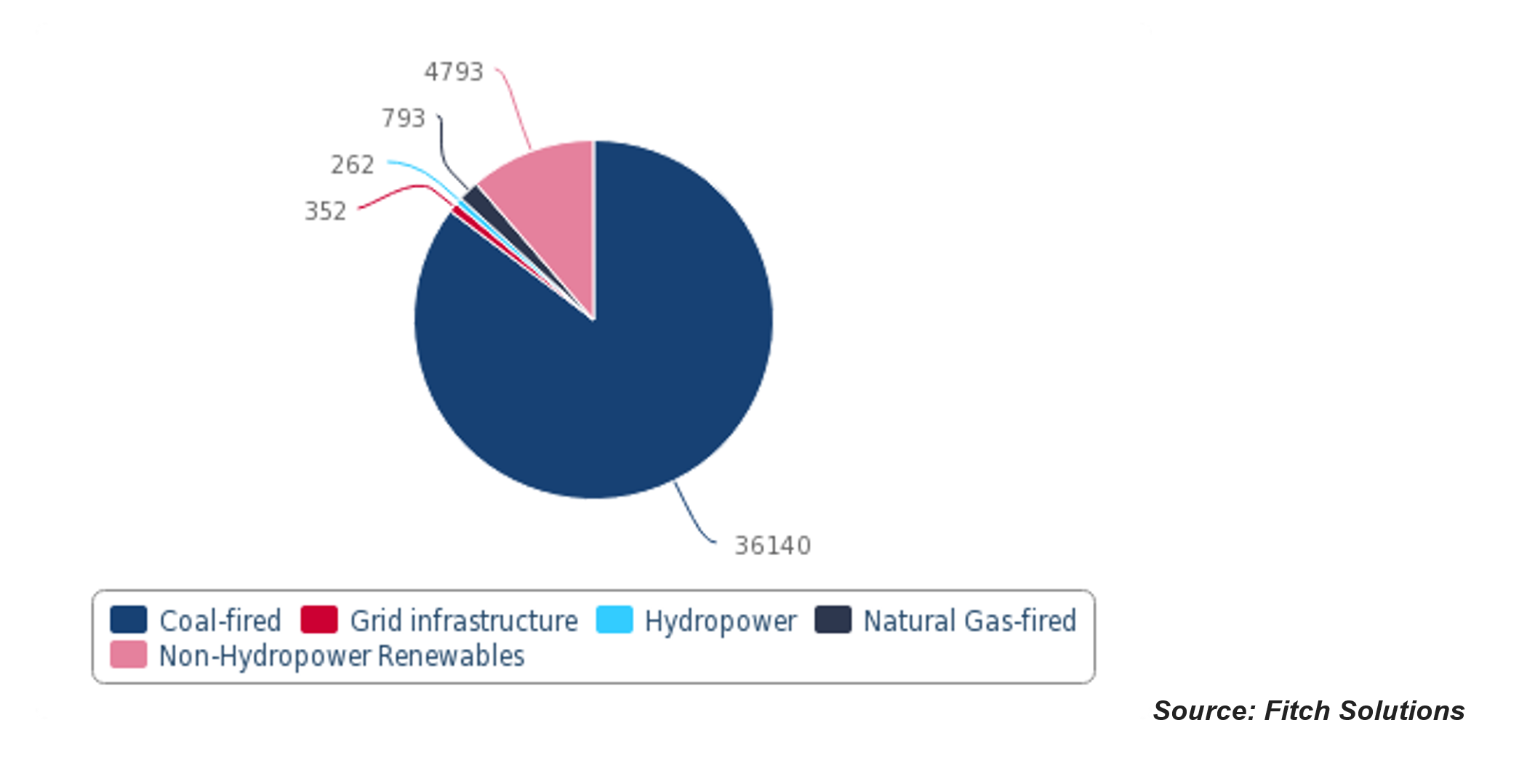
energy
Vietnam – Value of Power Infrastructure Sub-Sectors, USDmn
Export opportunities:
LNG supply
Conventional power transmission equipment
Smart Grid technology to increase network stability and efficiency in system operation
U.S. Department of Commerce - International Trade Administration - U.S. Commercial Service

Slide 15
Key Messages ON pdp8
Electricity Demand under PDP-8 is marginally lower than PDP7R Forecasts
  Peak – 8.3%
  Total Energy Growth – 6.5%
Declining Interest in Coal – Increasing Focus on Gas and Renewables
  Coal is still in the mix
    Current coal capacity 20GW
    New Capacity – 9GW by 2025 and 8GW planned in next 5 years
  Move to Gas – 20 GW new gas-based capacity through 2030
  Go with the wind – Less than 1GW today – 11 GW by 2025 and 18 GW by 2030
  Planned solar capacity nearly been reached – 18.6 GW by 2030 (at 16.6 GW)
Creation of new Power Infrastructure Procurement Agency under MOIT
U.S. Department of Commerce - International Trade Administration - U.S. Commercial Service

Slide 16
Challenges – RELATED TO PDP8
Potential Power Shortages in Short-Term
  Delays of implementation of projects and decision making
  Delays of transmission lines
  Particularly in the north
Development of Grid Infrastructure Unable to Keep Pace with Renewables
Need for Large Investment from International Community
  $133.3 billion USD from 2021-2030
    $100.4 billion for generation
    $32.9 billion for transmission
U.S. Department of Commerce - International Trade Administration - U.S. Commercial Service

Slide 17
Opportunities & Programming
Export opportunities:
LNG supply
Conventional power transmission equipment
Energy Efficiency & Smart Grid technology
Solar & Wind
Upcoming Programs:
Energy Efficiency in Vietnam’s Infrastructure and Logistics – April 2020
Developing Vietnam’s Standards in the LNG Industry – In partnership with USTDA & API
  June 2020
Asia EDGE Trade Mission – September 16-20
U.S. Department of Commerce - International Trade Administration - U.S. Commercial Service

Slide 18

Healthcare
Challenges and Opportunities
Per capita income is on the rise.
Middle class expected to double by 2020 - accounting for 50% of the population.
Affluent class is growing faster than any economy in the world.
Increasing expectations by Vietnamese citizens for the delivery of healthcare services
Non-communicable diseases impacting people’s lives.
Percent of population enrolled in universal health is increasing.
Overcrowded hospitals with outdated equipment
Public hospitals rely largely on a State budget. The total budget for the health sector has increased but is still too low to meet the demands.
Increasing burden on the existing healthcare system
U.S. Department of Commerce - International Trade Administration - U.S. Commercial Service

Slide 19
Healthcare
Challenges and Opportunities
GDP per capita is on the rise
Middle and affluent class is growing rapidly: Currently it accounts for 13 percent of the population, is expected to reach 26 percent by 2026 (The World Bank).
Healthcare Facilities – public/private mix: Public hospitals are divided into three levels, central (47), provincial (419) and district (684). 182 private hospitals.
Universal health enrollments increasing: More than 90% of Vietnamese people are currently covered by the National Health Insurance
Overcrowded hospitals with outdated equipment
Public hospitals rely largely on a State budget. The total budget for the health sector has increased but is still too low to meet the demand.
Increased expectations for high quality healthcare services
Increasing burden on the existing healthcare system
U.S. Department of Commerce - International Trade Administration - U.S. Commercial Service

Slide 20


Healthcare
Market Size – Best Prospects
Increased GVN Spending: Healthcare expenditure per capita is estimated to grow 9.2% / year through 2025, reaching $184 in 2021 (around $18 billion in total spend), and $262 by 2025 (Healthcare White Book, AmCham Ho Chi Minh City, 2020).
Medical Devices: Total investment in the medical device market has grown strongly, and 95% of medical equip. & supplies are imported. The medical device market was valued at $1.4 billion in 2019 with an average growth rate of 10.6% in the period of 2013- 2018 and is estimated to grow at 10.2%/year over the next 5 years.
Building Local Expertise, Local Hubs: The Covid-19 pandemic exposed weaknesses in Vietnam’s healthcare supply chain and now Vietnam’s central and city government, HCMC especially, are driving to build healthcare hubs, putting significant efforts in attracting FDI.
Opportunities:
  Infrastructure: Private sector first, public hospitals second.
  Devices: The most imported devices include Laboratory Equipment, Disease Management, and Diagnostic Imaging Equipment (X-ray, Ultrasound, Magnetic Resonance Imaging, Computed Tomography Scanners, and Equipment used for Surgery, Endoscopy, Sterilization, Testing and Medical Waste Treatment).
U.S. Department of Commerce - International Trade Administration - U.S. Commercial Service

Slide 21
Healthcare
  Activities, Opportunities and Programing
Commercial Diplomacy:
  Extension of Marketing Authorization (Pharma)
  Certificate of Pharmaceutical Product (Pharma)
  Negotiation Mechanism for Off Patient Originator (OPO) Drugs (Pharma)
  Declaration of U.S. manufacturer sites in the U.S. (Pharma)
  GMP Listing, GMP Notarization (Pharma)
  Registration for Circulation of Medical Devices (Devices)
Advocacy Services (GVN Procurements)
Business Facilitation: All Commercial Service GKS, IPS Plus, ICP, SCP
Opportunities:
  Virtual Trade Mission: May 2021 (May 25-28, 2021): Virtual Trade Mission for Medical Technology (Oncology, Cardiology and Health IT focus). Vietnam, Malaysia and Thailand.
  Ho Chi Minh City: Aggressively pushing to become a healthcare hub for Vietnam, and the Region
  Webinars: Webinars to Explore and Discuss Collaboration Opportunities with Hanoi and Hai Phong City
U.S. Department of Commerce - International Trade Administration - U.S. Commercial Service

Slide 22
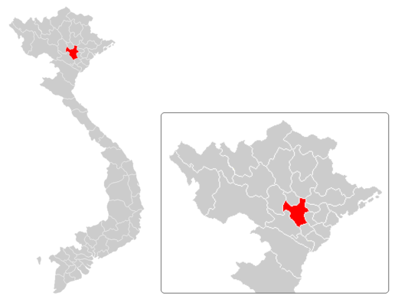
Smart Cities
Hanoi
Twenty-six cities and provinces
Export opportunities:
Business analytics software
E-government solutions
Advanced metering infrastructure
Smart grid technology
Smart street lighting
Intelligence traffic management solutions
Emergency response solutions
Cybersecurity solutions
Hue
Da Nang
Ho Chi Minh City
Can Tho
Nha Trang
U.S. Department of Commerce - International Trade Administration - U.S. Commercial Service

Slide 23

SELECT U.S.A.
Founded in 2007
A summit held by the U.S. Department of Commerce's International Trade Administration
To promote foreign direct investment to the U.S., contributing to U.S. job creation, innovation, and competitiveness

Slide 24
Doing Business in Vietnam
Challenges – Structural
Underdeveloped laws & regulations in many sectors, i.e. environment, healthcare, PPP etc. Lack of government capacity to implement existing laws & regulations. Decrees issued caused “unintended” consequences. Lack of consistency in the application of existing regulations. Challenges: Business, Social, others Insufficient talent pool at the middle-senior management level There’s a popular perception that since opening, foreign MNCs are the primary beneficiaries of government policies/largess Government policies to promote national champions Weak IPR protection Still very much a relationship driven economy Corruption

Slide 25
Final Thoughts
No shortcut to doing due-diligence
Management needs to have mid-to-long term view
Resources to substantiate Vietnam strategy
No substitute to having a strong local partner, local staff
Relationships with local authorities, tendering agencies and technical designed institutes

Slide 26


Thank you! – Cảm ơn!
Contact us at:
  +84-24-3850-5199
  Ryan.Hollowell@trade.gov
http://trade.gov/vietnam

